Slide 1


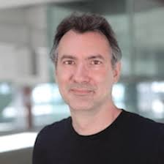

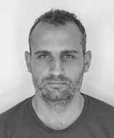

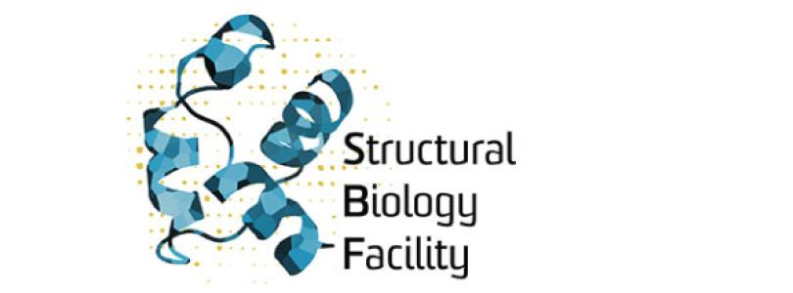
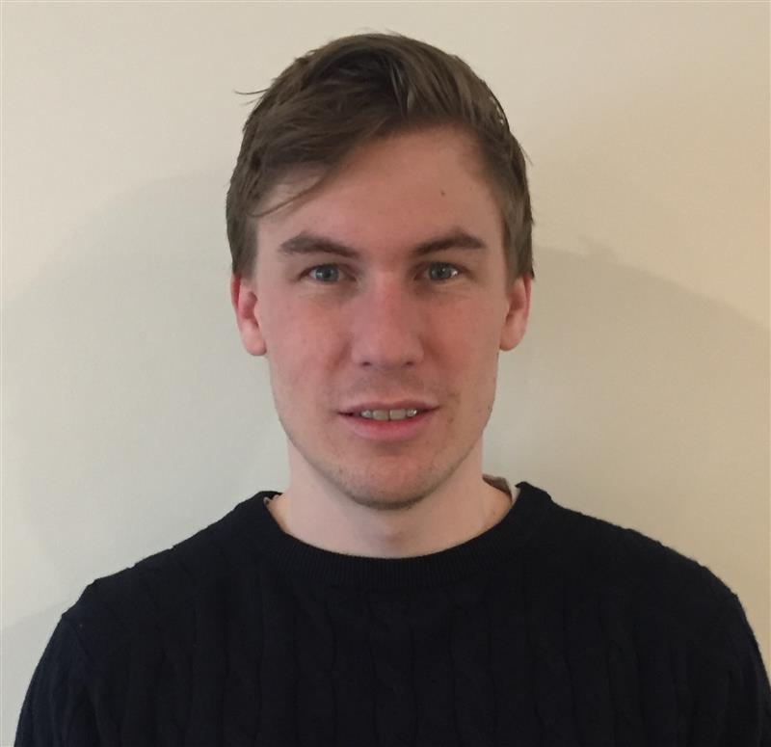
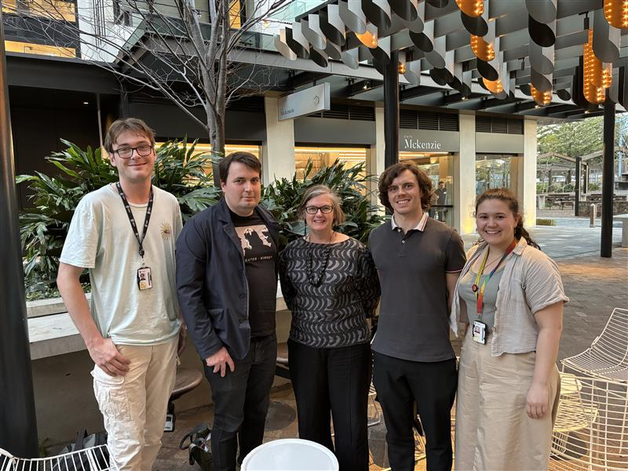
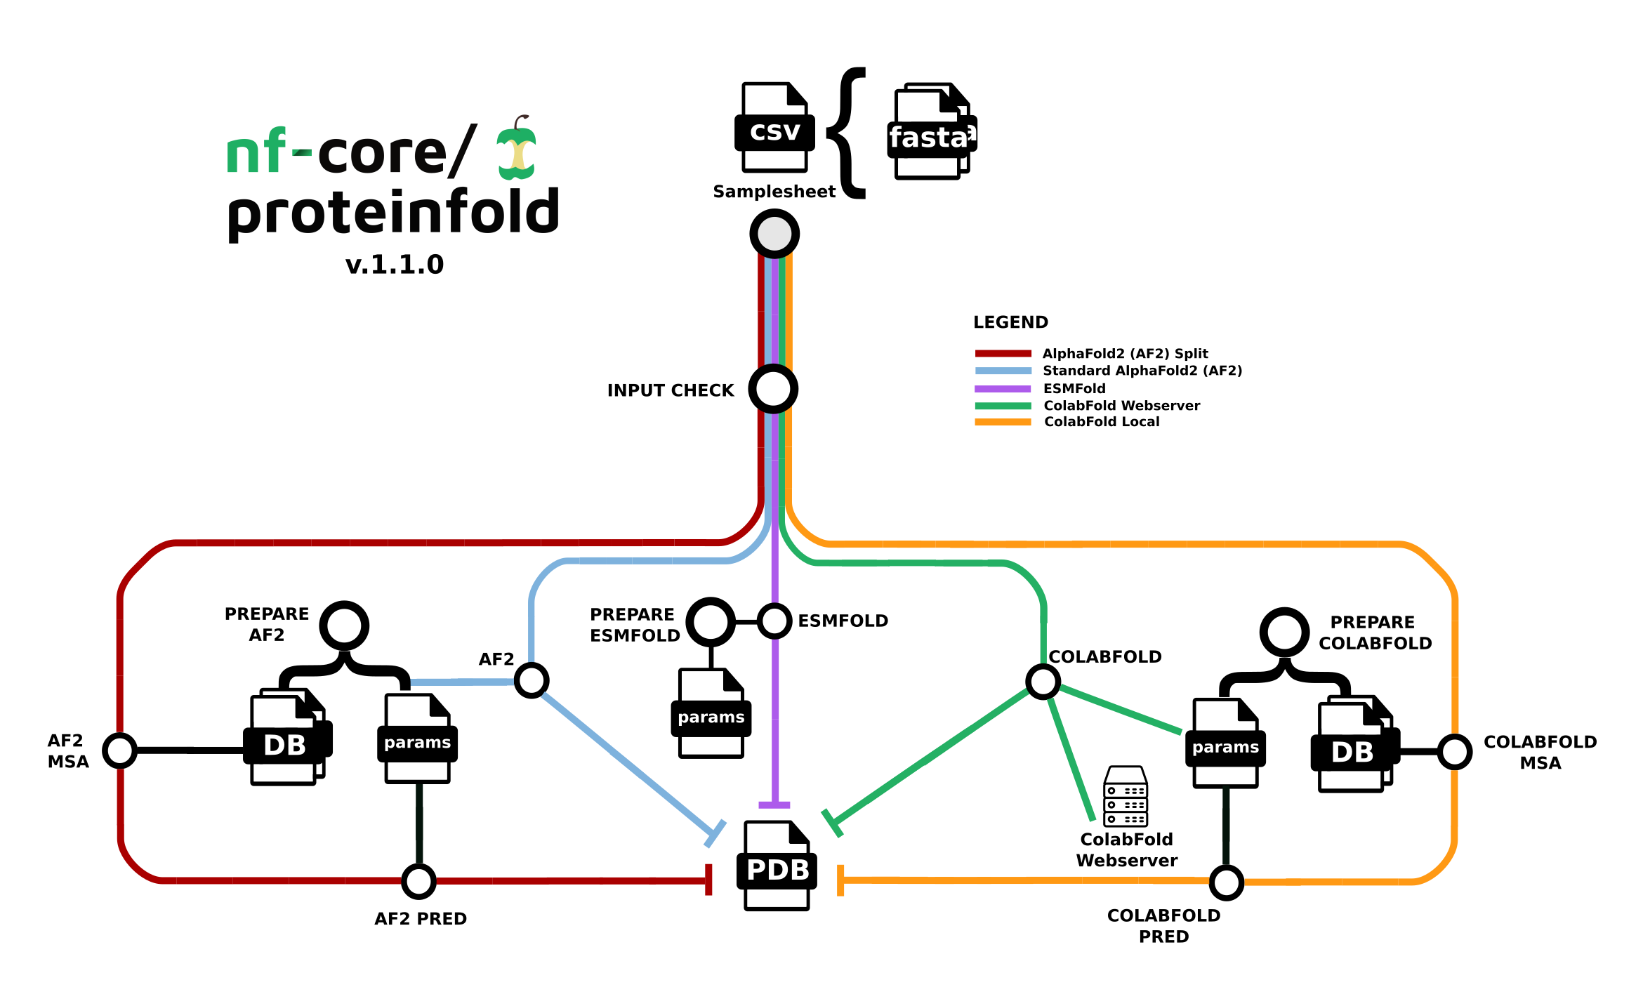
Working with ProteinFold High performance protein structure prediction from a spreadsheet
Melbourne Bioinformatics Meetup - 2025 June 26
Dr Keiran Rowell

Slide 2

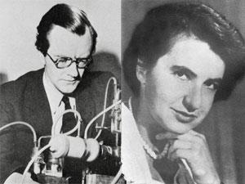
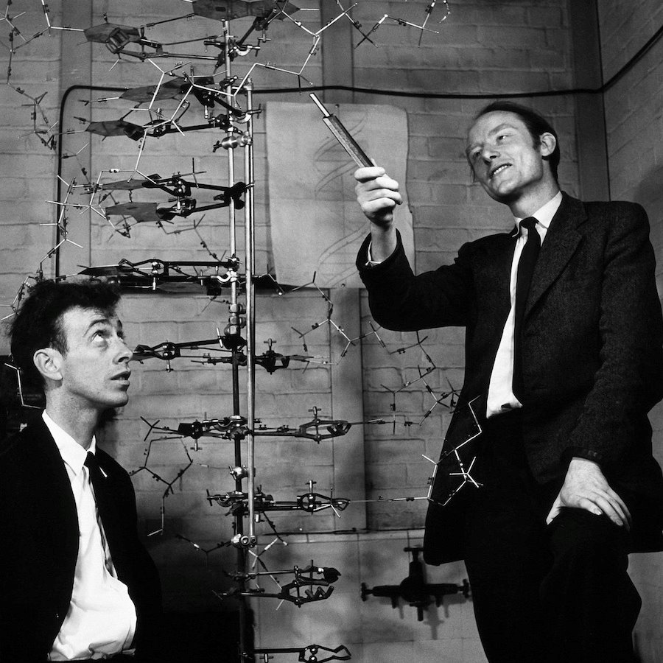
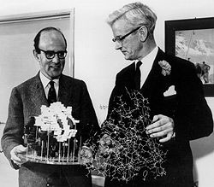
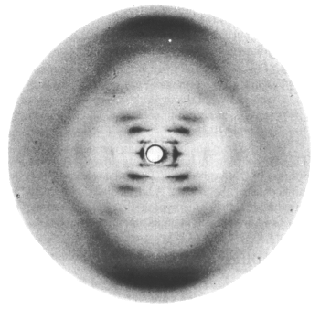
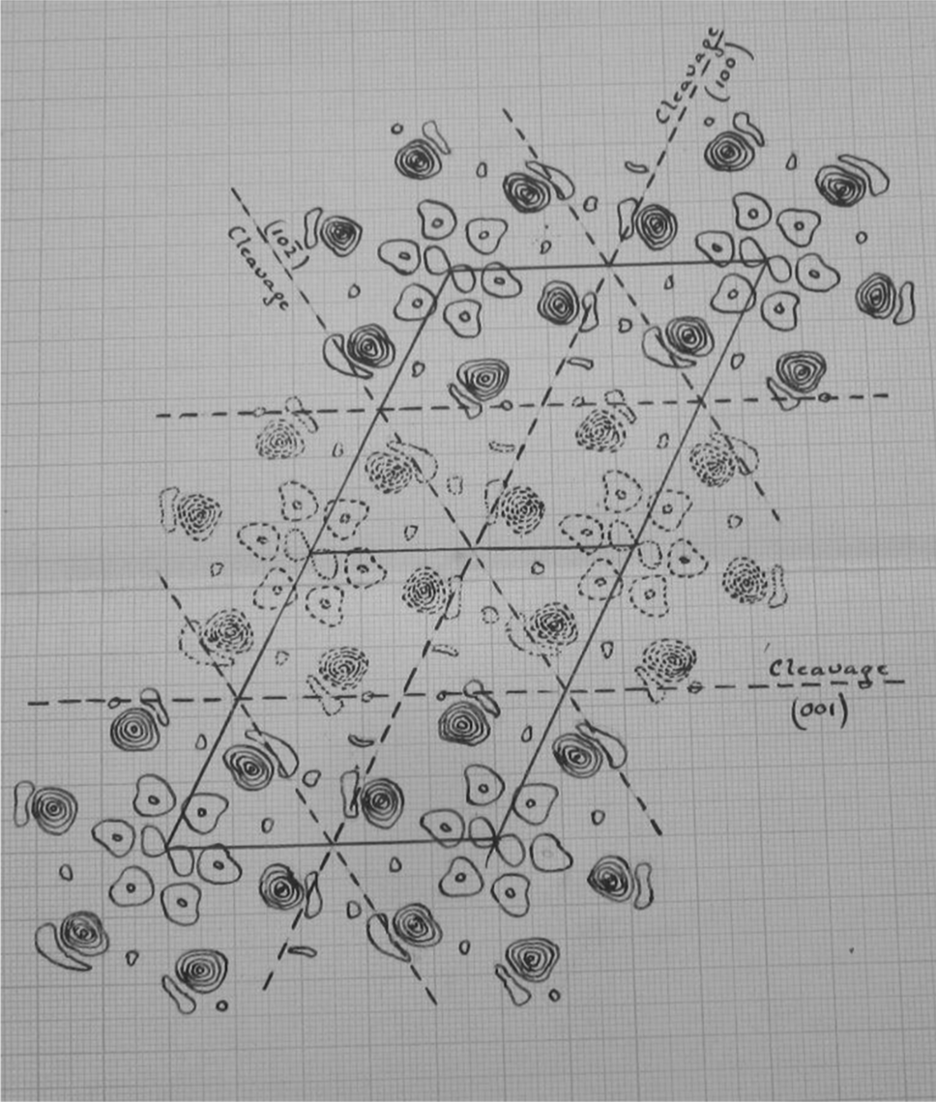
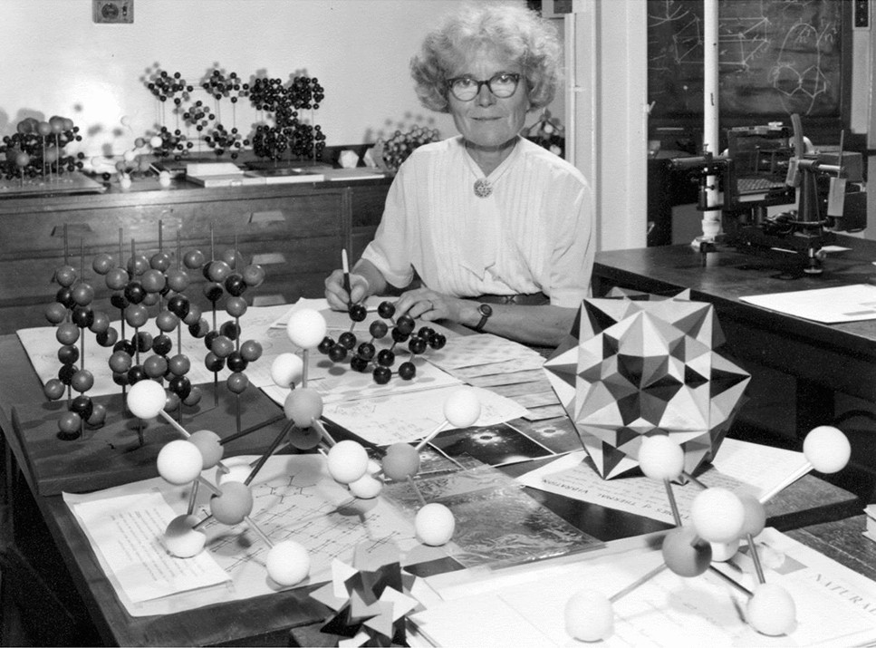
Models in Chemical Biology - function follows chemical form
Schrödinger speculates on
the molecules of life 1944
Perutz & Kendrew's model of the 3D structure of a protein (myoglobin) 1957 ​
Watson & Crick's DNA double-helix model 1953
Wilkins & Fraklin's X-ray diffraction images of DNA 1953
Kathleen Lonsdale resolves the structure of (hexamemthyl)benzene 1929

Slide 3
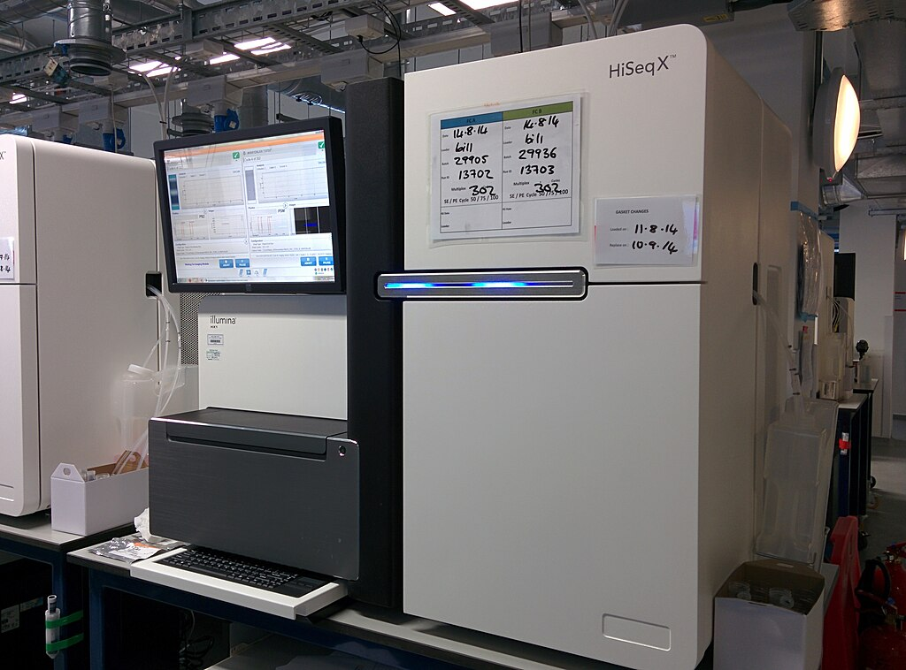
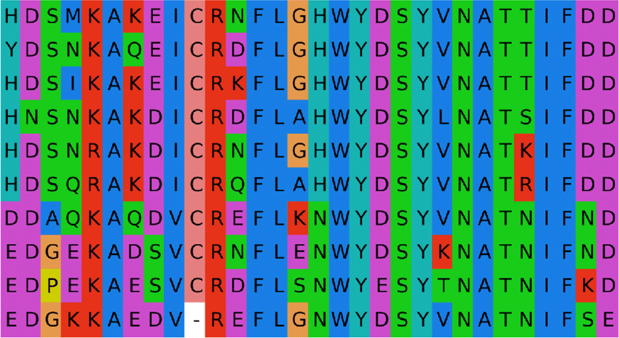
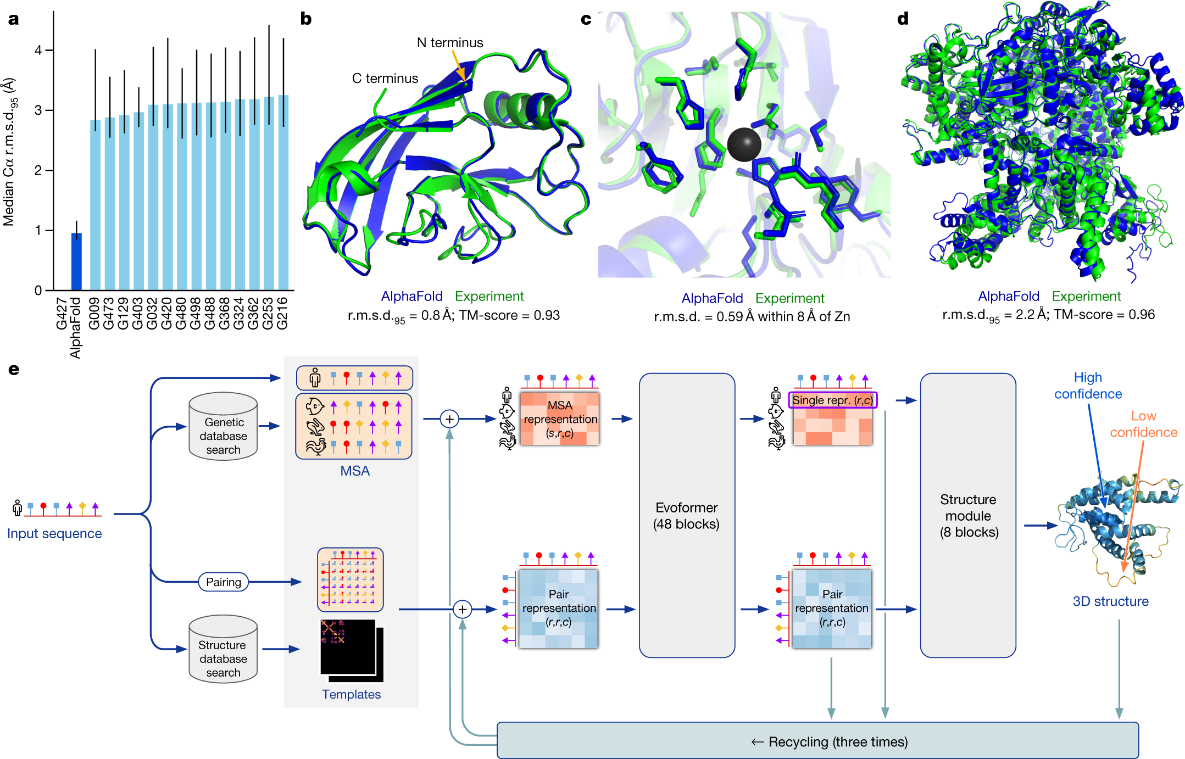
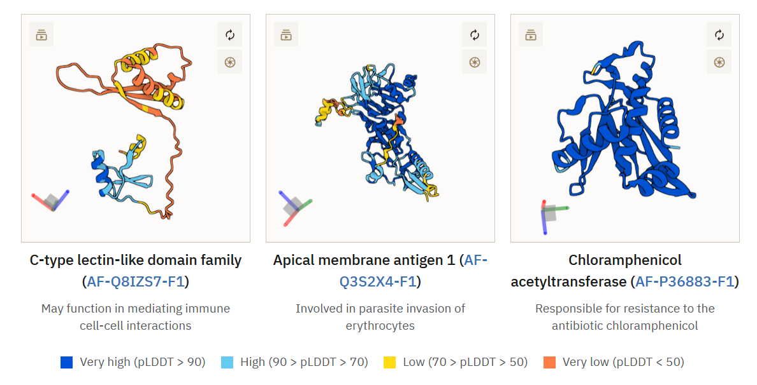
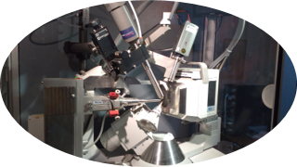
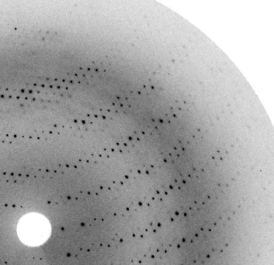
Deep Learning trained on experimental data
From genetic sequence
To modelled structure prediction
via computer
From protein
structure
Source: https://www.ebi.ac.uk/training/online/courses/alphafold/inputs-and-outputs/evaluating-alphafolds-predicted-structures-using-confidence-scores/plddt-understanding-local-confidence/

Slide 4
AlphaFold2 A leap forward in computational prediction accuracy
Fig. 1: AlphaFold produces highly accurate structures – from "Highly accurate protein structure prediction with AlphaFold" - Nature, 596, 583-89 (2021).
Improvements
More than 2x as accurate as anyone else​
The global fold reliable when compared to very expensive experiments​
Set the algorithm architecture that is that standard today​

Slide 5









Tutorial only on protein folding - X'Fold' programs
The largest Big Tech and academic groups in world have dedicated serious expertise and resources into developing these programs.
They are mostly free and open source (academic, non-commercial work). If you develop the skills to run the code on local hardware.
https://github.com/google-deepmind/alphafold
https://github.com/google-deepmind/alphafold3
Need a unified workflow method!​
https://github.com/facebookresearch/esm
https://github.com/aqlaboratory/openfold
https://github.com/bytedance/Protenix
https://github.com/jwohlwend/boltz
https://github.com/sokrypton/ColabFold
https://github.com/baker-laboratory/RoseTTAFold-All-Atom

Slide 6
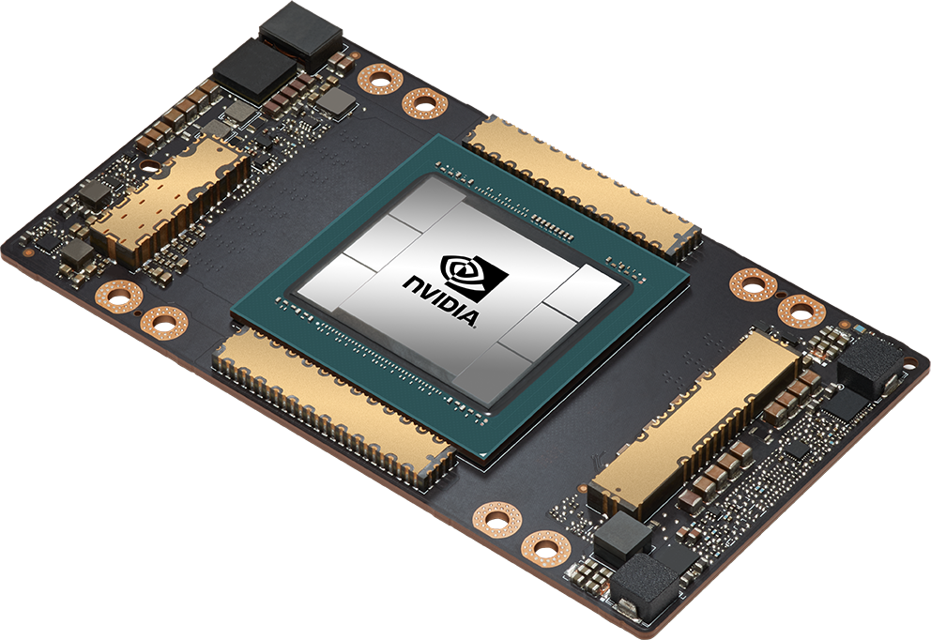
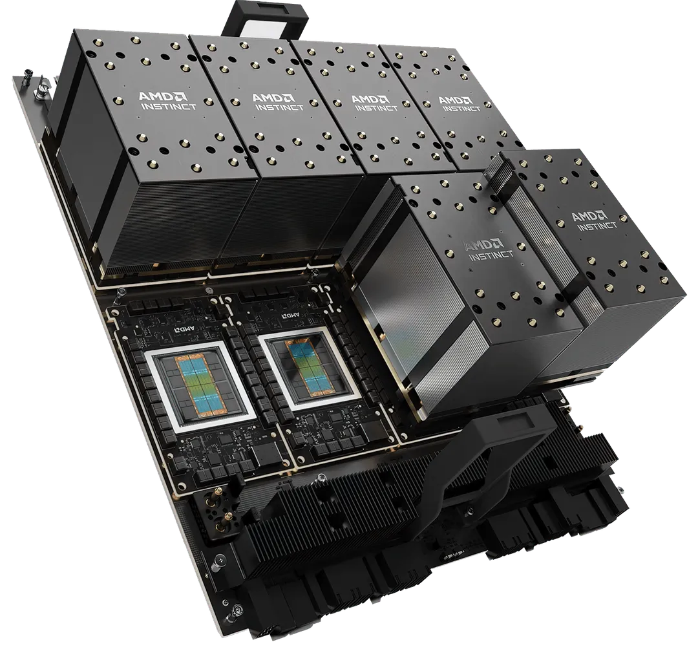
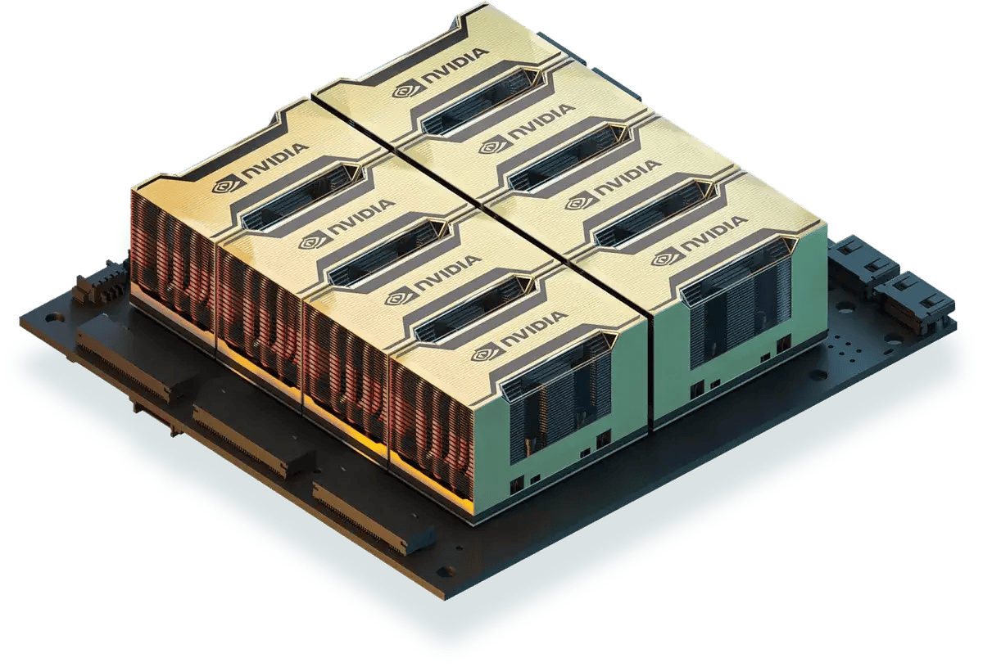
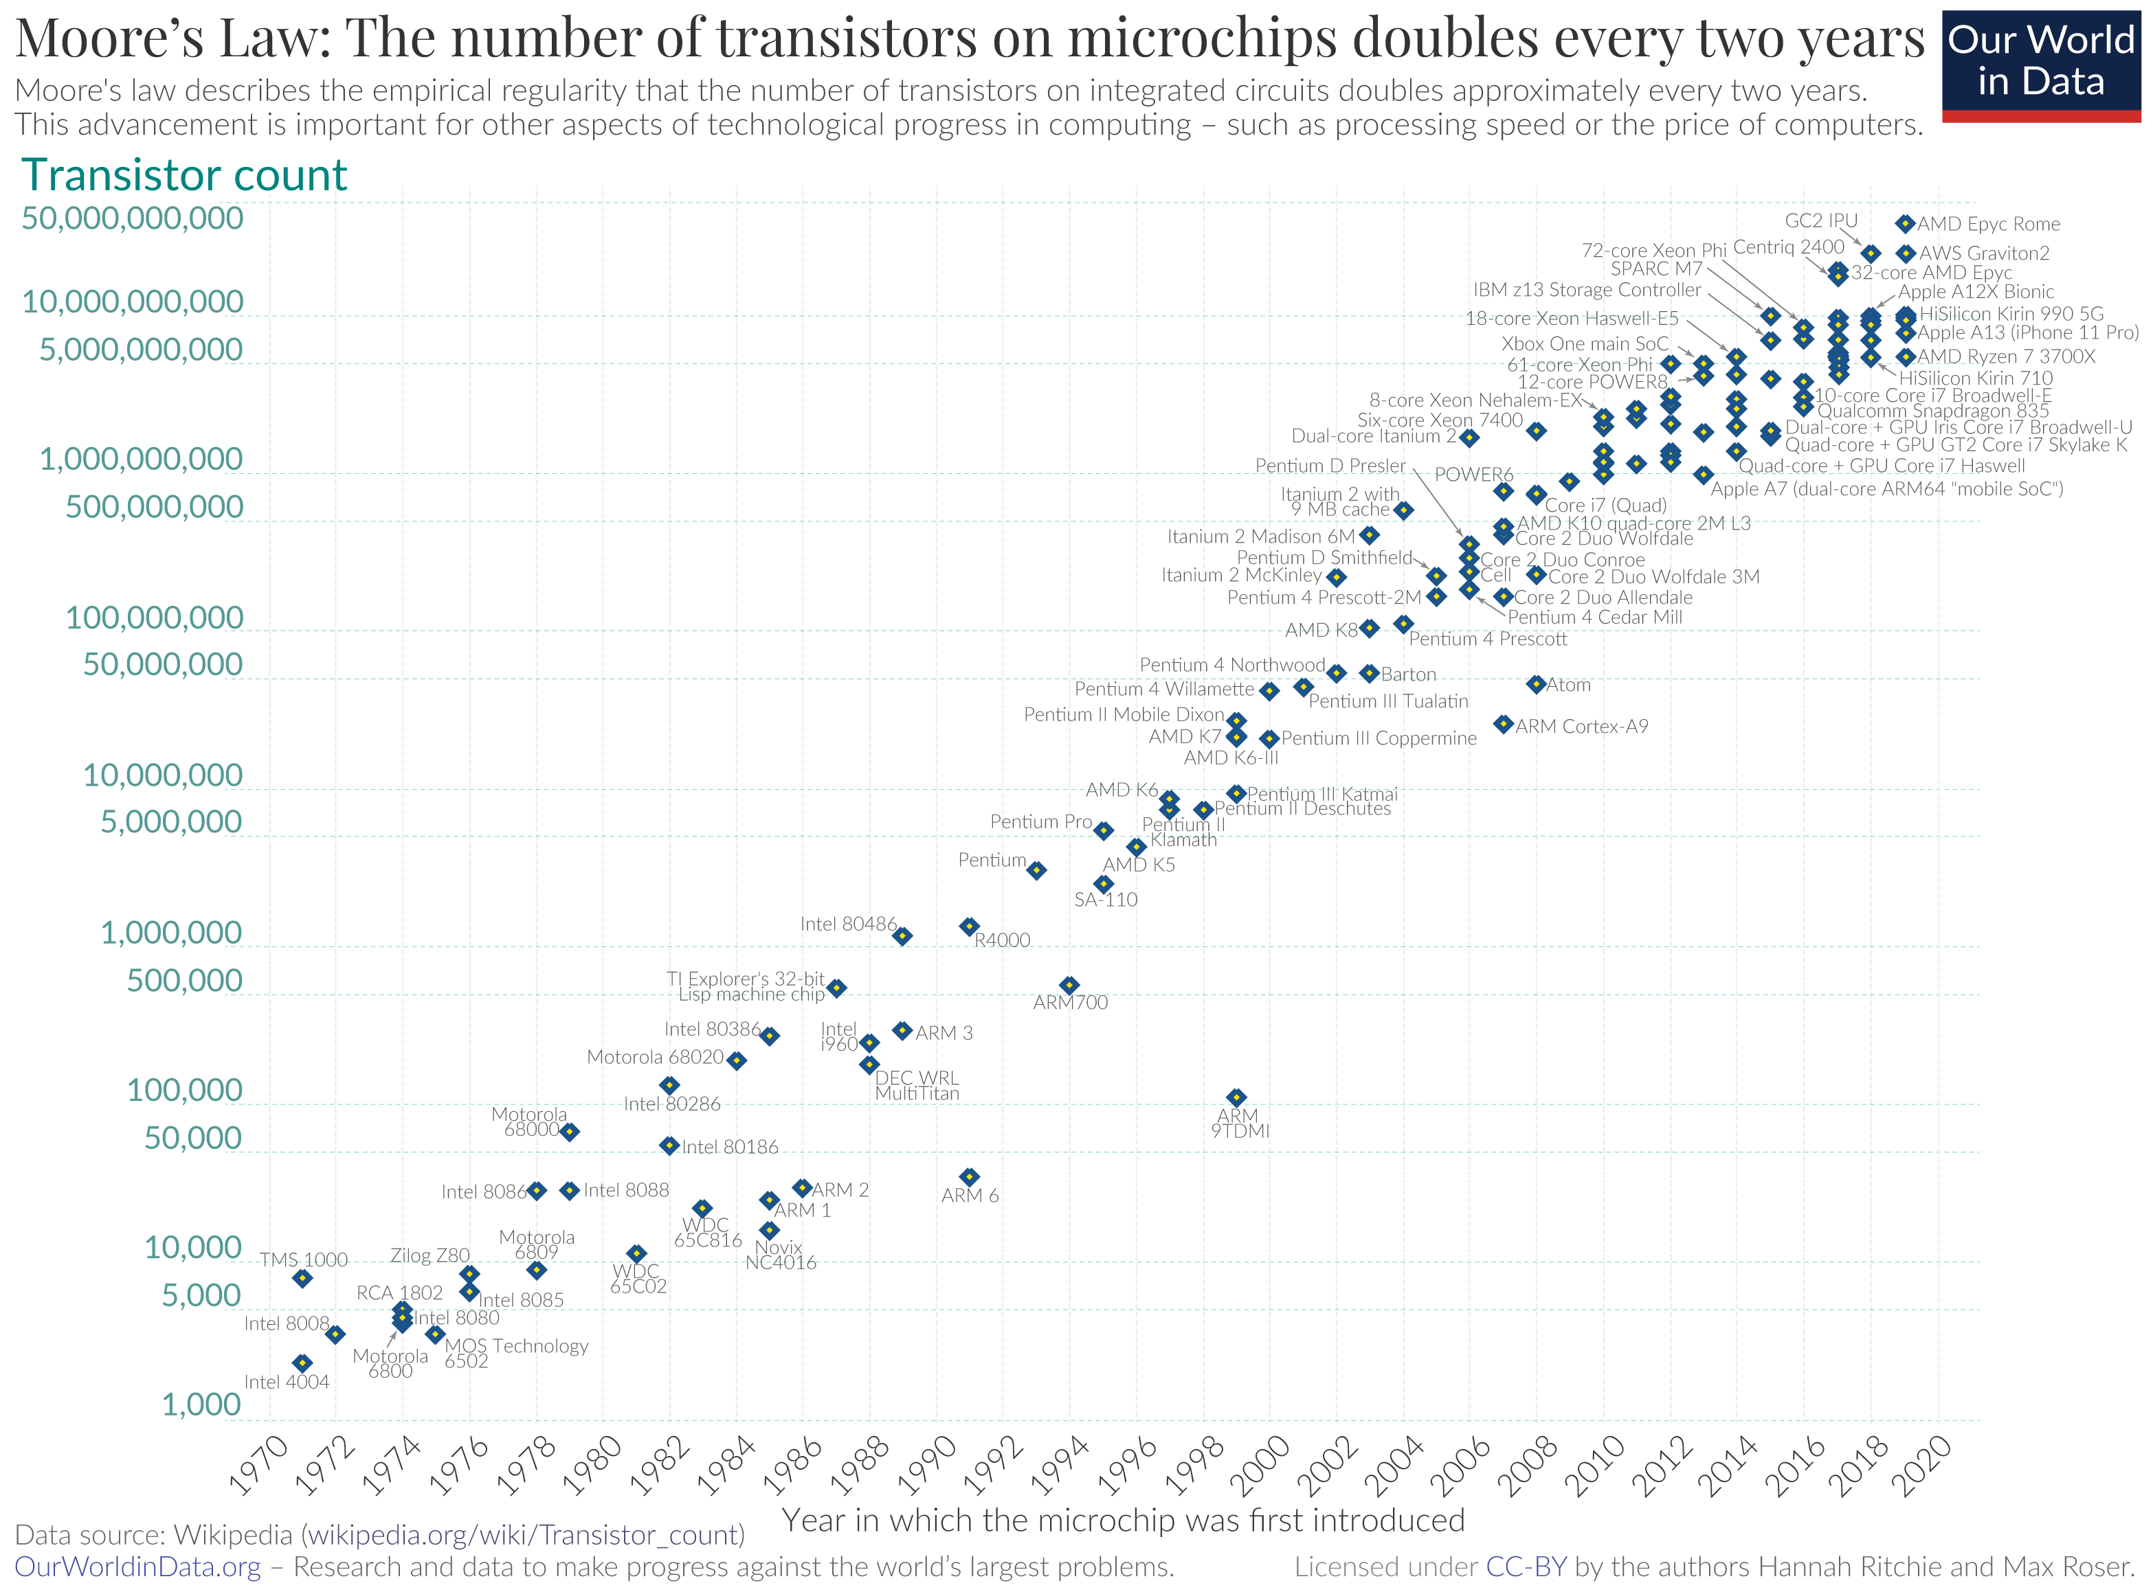
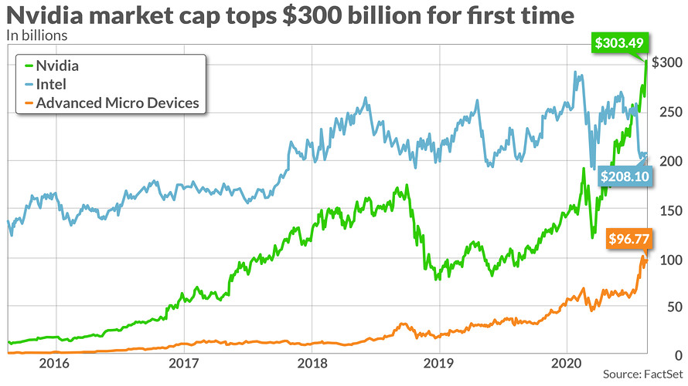

GPUs – Multiply things really fast
Now ~100 billion transistors in each GPU
100s of trillions multiply ops each second
93 million parameter network less scary
NVIDIA - AMD
Both design GPUs
½ of NVIDIA are software engineers
Sequence alignment is the rate limiting step!
We can't keep GPUs busy! They are so fast
GPU calculations x50 faster than CPU. 2 hrs vs 5 days
ESMFold is pure GPU. AlphaFold GPU+CPU+DB retrieval.
613 proteome 8 hrs vs 22 days. 4,622 protoeome 10 days vs ?? (2 years)

Slide 7
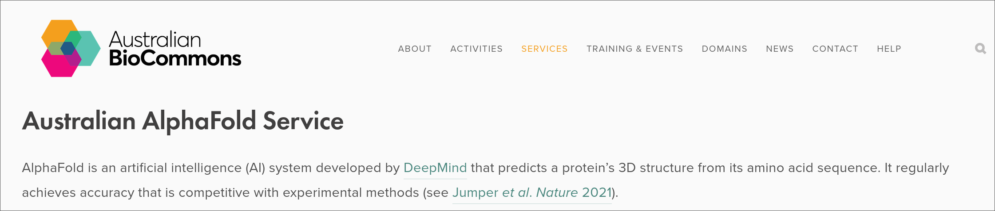
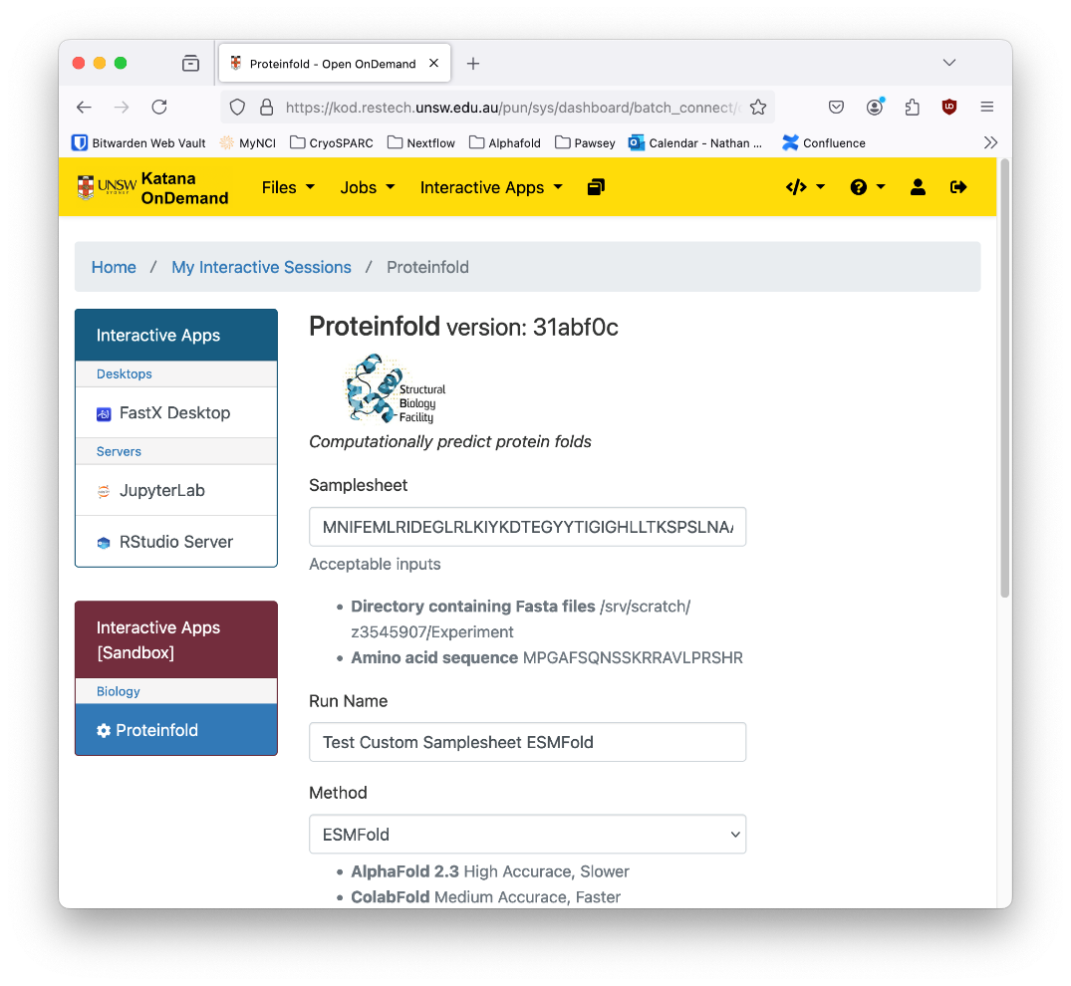

Where to turn? - Galaxy, Uni compute cluster, ProteinFold
ABLeS: Pawsey AMD (1017) – NCI NVIDIA (za08)

Slide 8
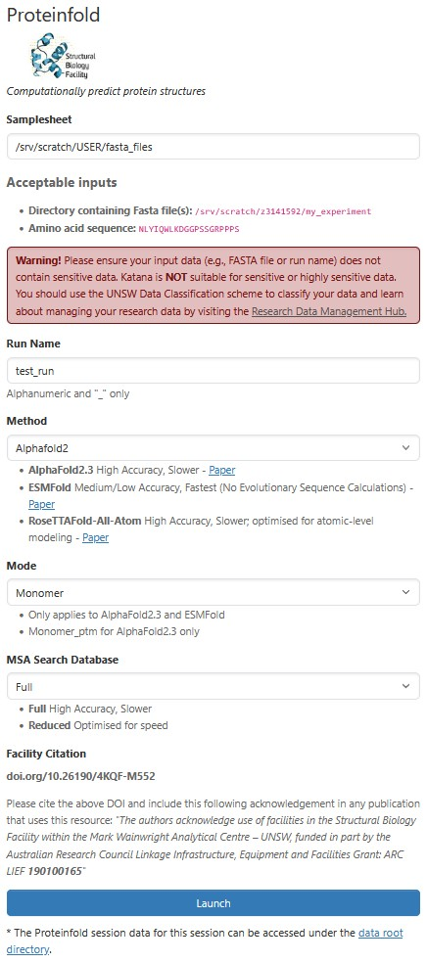
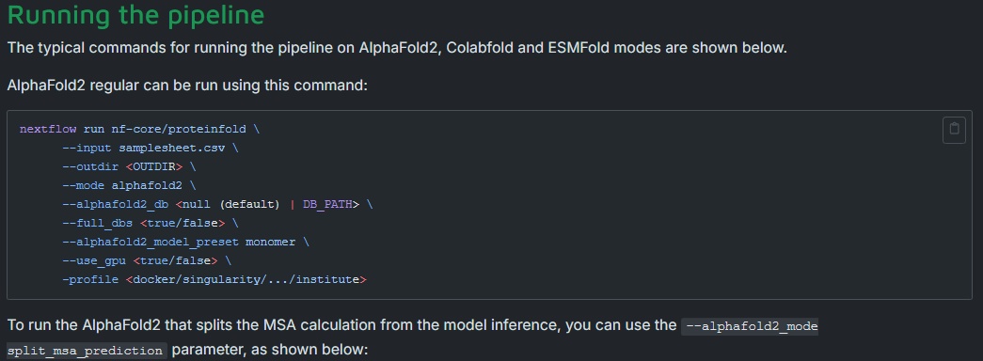
Live Demo – ProteinFold Terminal vs Web

Slide 9

What's new in ProteinFold v2? - adventures in dev
Over the past year:
Programs:
AlphaFold3 (BYO weights)
Boltz (v2) – Unrestricted (MIT) AlphaFold3
RosettaFold-All-Atom (Institute of Protein Design)
HelixFold3 (Baidu) – AlphaFold3 re-implementation
Reports:​
HTML5 – interactive structure visualisation
FoldSeek – auto fetch structural annotations
MultiQC (might be v2.1) – Metrics for bulk folding
Versioning – pipeline keeps track of container and database versions
Features:​
Quality Metrics – (MSA depth, pLDDT, PAE, iPTM)
CPU vs GPU process labels – efficient computing
NextFlow – understands on-prem or cloud scheduler
Shared databases (3 TB) – who wants 5 UniRef30s?
Containers – some repos already abandoned!
MSA reuse (might be v2.1) – MSAs are slooow

Slide 10
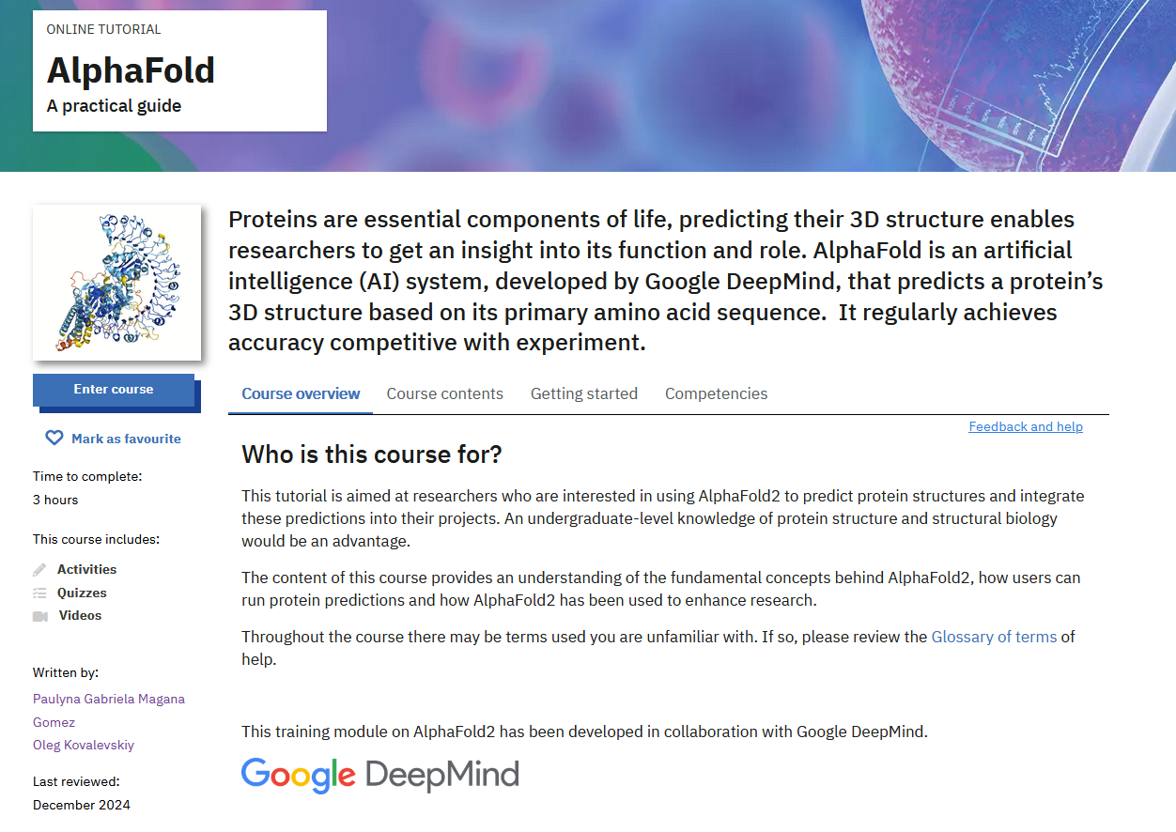
Self-learning – spend 3 hrs with the pros!
https://www.ebi.ac.uk/training/online/courses/alphafold/

Slide 11
Questions / Discussion
Facility: unsw.edu.au/research/facilities-and-infrastructure/find-a-facility/sbf
Pipeline: nf-co.re/proteinfold/
My site: keiran-rowell.github.io/

